Slide 1
G2M insight for Cab Investment firm
XYZ is a private firm in US. It's because of the remarkable growth in the Cab industry in recent years and multiple key players that it's planning for an investment in this market. Before taking final decision, it wants to understand the market better.

Slide 2
Understanding the data
The time period of the data is between January 2016 to December 2018. The data sets include;
Cab_Data.csv – contains information about transactions for 2 cab companies.
Customer_ID.csv – has a mapping table that contains a unique identifier that links the customer's demographic details.
Transaction_ID.csv - this is a mapping table that contains the transaction and payment mode
City.csv - this file contains list of US cities, their population and number of cab users.
US Holiday Dates (2004-2021)-this is a table containing holiday dates in the USA.
All these data sets were combined to form one master data set that was used for data analysis.

Slide 3
Profit Analysis
Average profit per Kilometer for the 3 years
Profit Made per ride

Slide 4
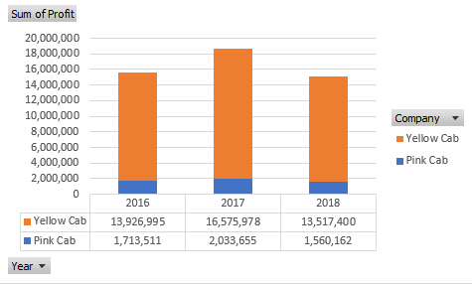
Profit analysis
Average profit per km in USA cities

Slide 5
The number of taxis hailed are higher in from Friday to Sunday
Average profit per month

Slide 6
Demographic Analysis
Profit distribution among income levels
Profit distribution among age groups
The Yellow cab is also the preferred cab service for people with an income ranging between $2,000 and $21,999 per month.
People in the 18-to-37 age group make up the majority of Cab's customer base, and they prefer to use the Yellow Cab's services.

Slide 7
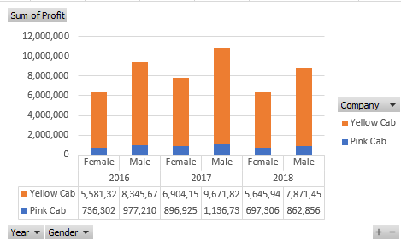
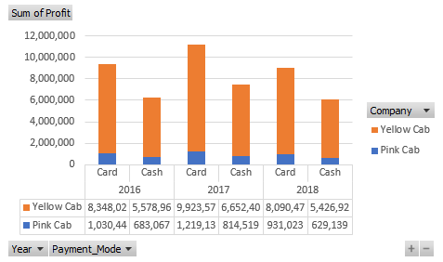
There are more male customers than female hence more profit from male customers
More people prefer making payment using card.

Slide 8
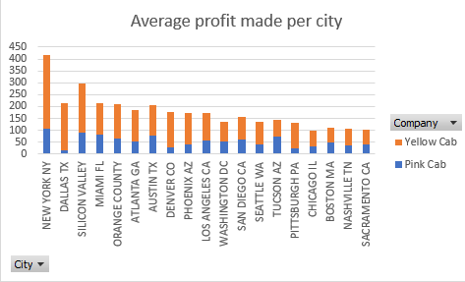
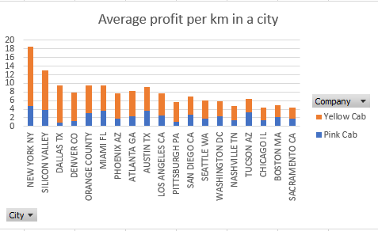
City analysis

Slide 9
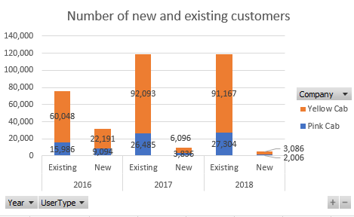
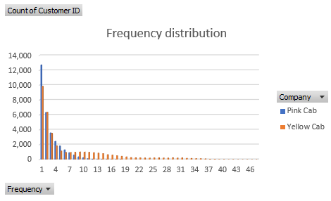
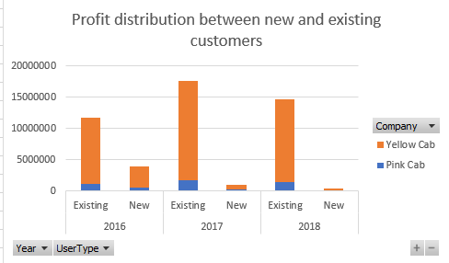
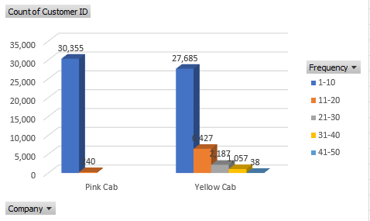
Customer Retention
Yellow cab has developed loyalty among its customers, with some passengers riding up to 40 times.

Slide 10
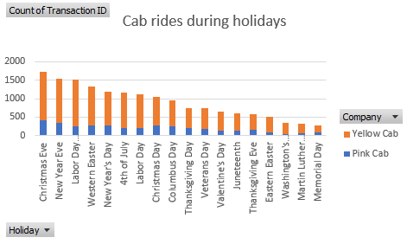
Holiday Analysis
People tend to travel more on the day before the major holidays like Christmas eve and New year’s eve.

Slide 11
Pink Cab Forecast
1.63 % projected increase in profit for the year 2019

Slide 12
Yellow cab forecast
3.94% projected increase in profit for the year 2019

Slide 13
Conclusion
Profit-In terms of revenue per ride and revenue per kilometer, Yellow cabs earned the most. The yellow cab also earned the most money cumulatively over the 3-year period.
Customer retention-Yellow cab has developed a high rate of customer retention, with some passengers riding as many as 40 times. Most of the company's profits come from its established customer base.
Customer reach-The Yellow cab has a wider customer base than the Pink cab. It is the dominant cab service in most major cities in the United States, preferred by both genders, and preferred by people with an income between $2,000 and $21,999 per month who make up for most of the customers.
Forecast- The forecasted profit increases in 2019 are 3.94% for the yellow cab and 1.63% for the pink cab. The yellow cab company is projected to be the more profitable company in 2019.
I recommend investing in Yellow Cab stock, as the company looks poised to thrive in the coming years.

